Slide 1
SortAlgo
Presented by
Meheraj Hossain
Md. Sakib Khan

Slide 2
Outlines
Objectives
Resources
What is SortAlgo?
The project Structure
Project features
How the project works
Special tribute
Overview
Our Experience

Slide 3
Objectives
Implementation of C and C++ language programming.
Learning basic level graphics operations.
Producing something with real life significance.
To understand the sorting algorithms easily.

Slide 4
Resources
Used Code Blocks 16.01 version
Used Borland Graphics Interface(BGI)
Used Images Only for making co – relational interface with the users.
C/C++ learning sources.

Slide 5
What is SortAlgo?
SortAlgo is a platform for visualization of popular sorting algorithms with pseudocode.
SortAlgo is also a platform where user can manually sort the given numbers with visualization to better understand the algorithm.
Wrote in C programming language, with the help of Borland Graphics Interface (BGI)
Compiled in Code Blocks.

Slide 6
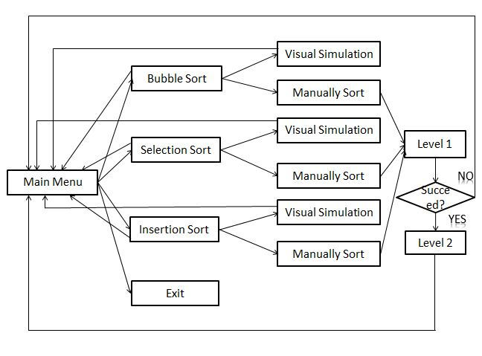
The project structure

Slide 7
Project Features
Here three types of sorting algorithms are visualized through animation with pseudocode.
-Bubble Sort
-Selection Sort
-Insertion Sort
User can also try to implement the algorithms manually with visualization to understand the algorithm properly.
There are two levels for all types of sorting algorithms.

Slide 8
How the Project works.

Slide 9
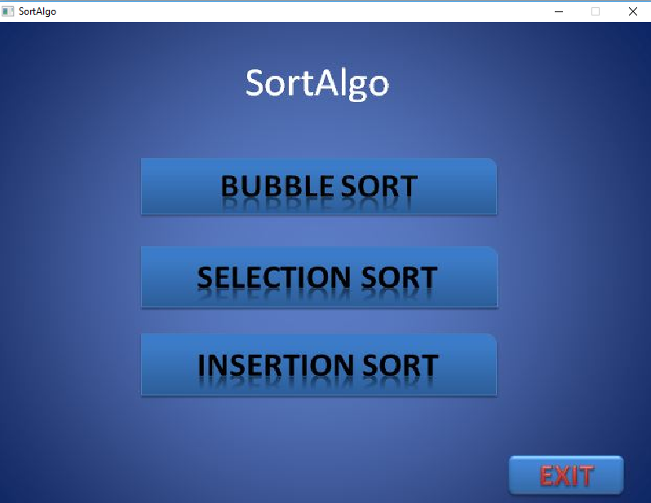
Main Menu
Here is the main menu page.
Here you can select any algorithm for visualization or manual sort.
To exit, Click on the EXIT button.

Slide 10
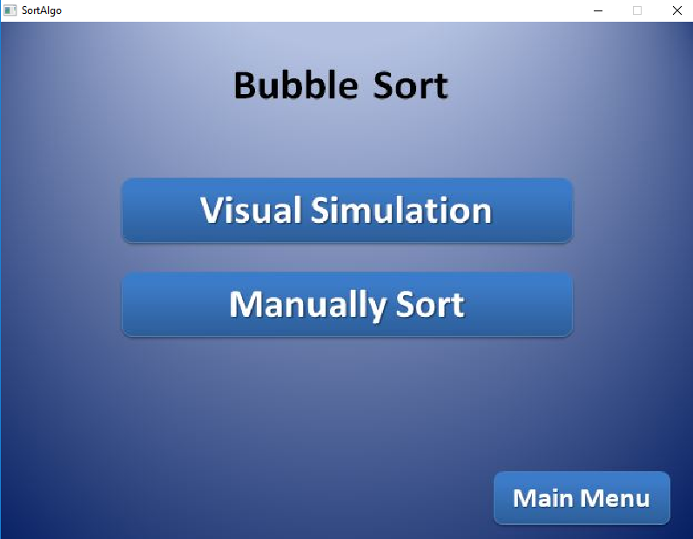
Bubble Sort
Here is the Bubble sort Menu.
By clicking on the visual simulation, you can see the visualization of Bubble sort through animation.
By clicking on the “Manually Sort”, you can try to sort the rectangles manually.

Slide 11
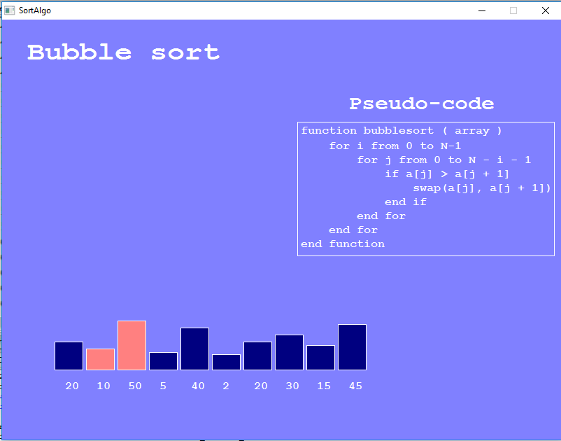
Visual Simulation of bubble sort
This is the scenario of the visual simulation of Bubble sort.
At the right, you can see the Pseudo-code of the bubble sort.
The rectangles marked with different colours denote the swap between them.

Slide 12
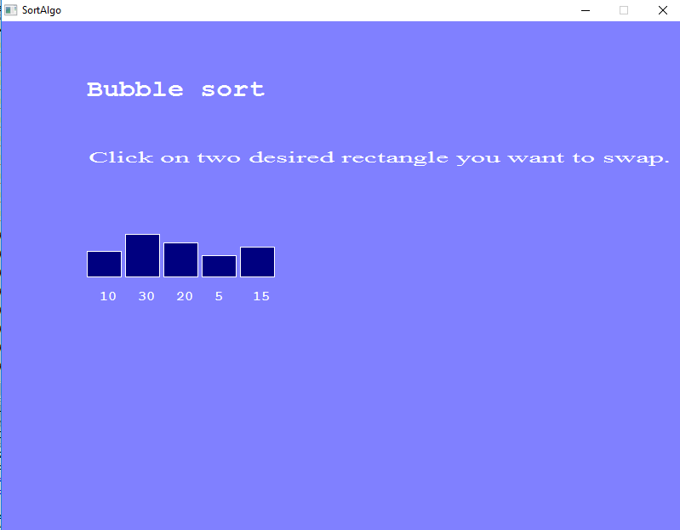
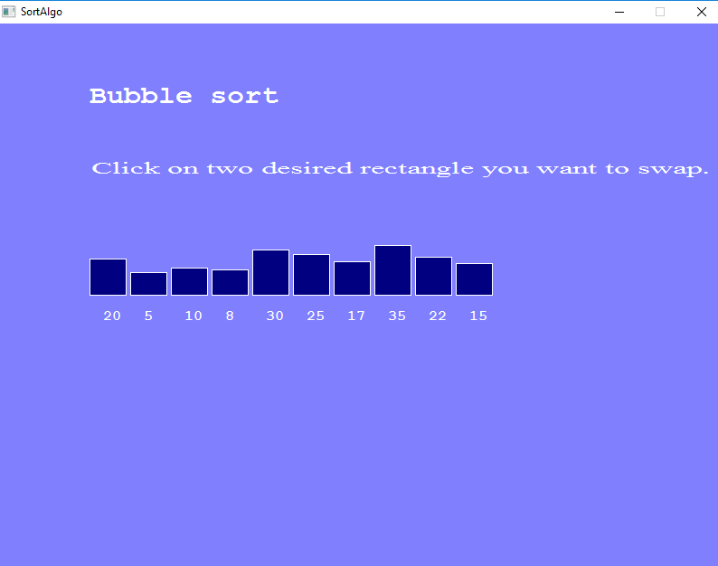
Manual Bubble sort
You can manually Sort here using bubble sort algorithm.
There are two levels. If you can succeed in the first level then you can go to the level two.
If your move is wrong then you will be directed to the main menu.
LEVEL 1
LEVEL 2

Slide 13
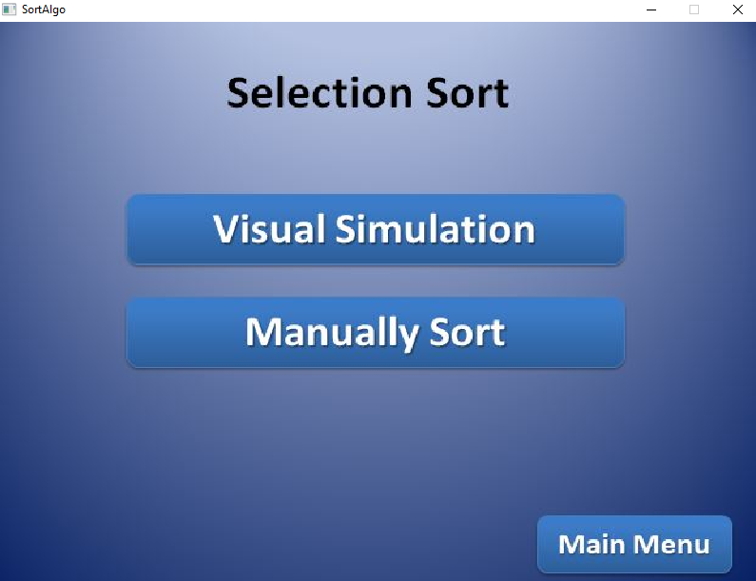
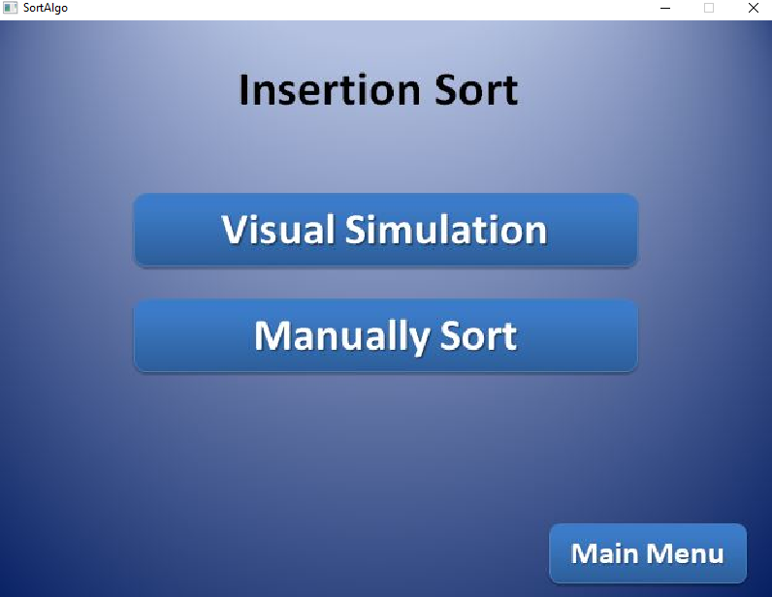
Selection Sort and Insertion Sort

Slide 14
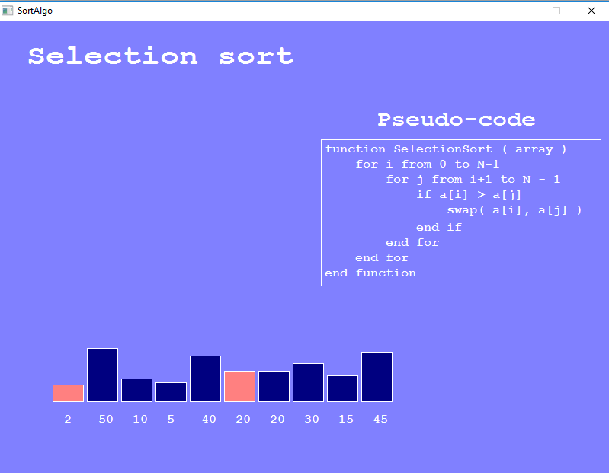
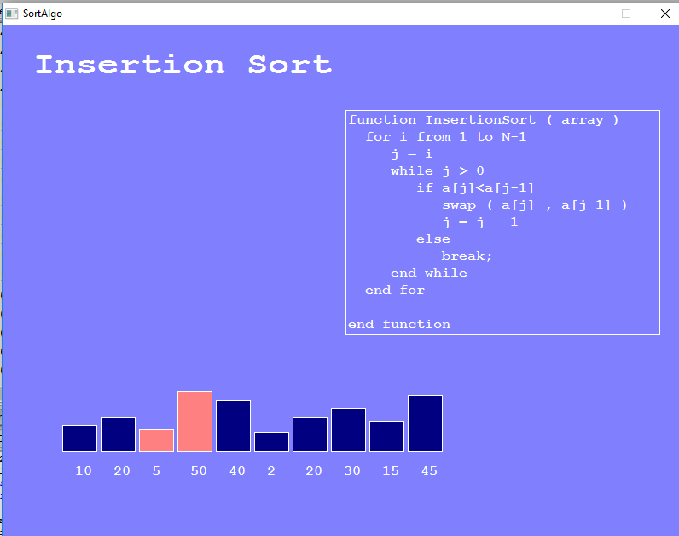
Visual simulation of Selection and Insertion sort

Slide 15
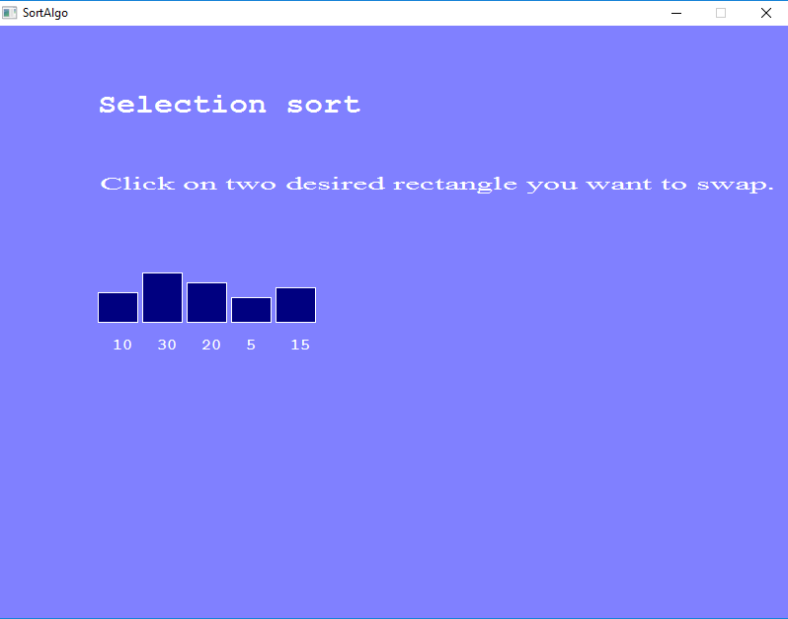
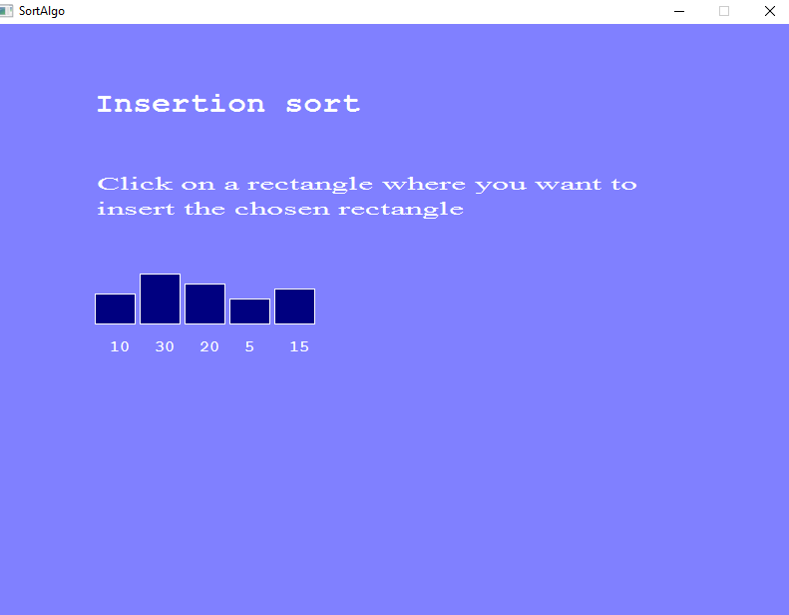
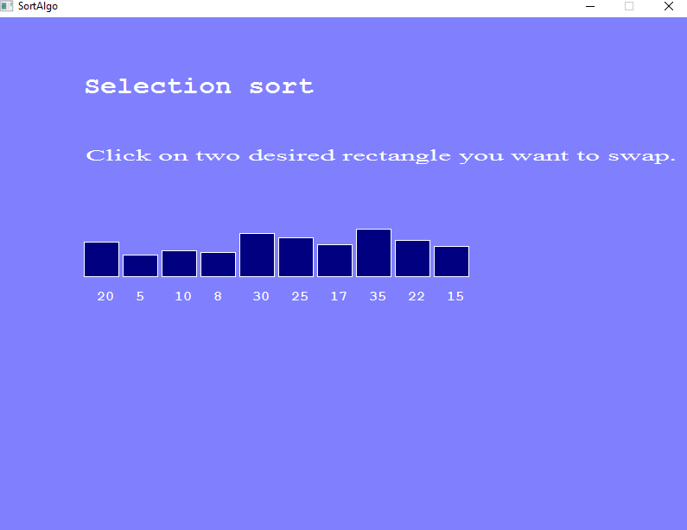
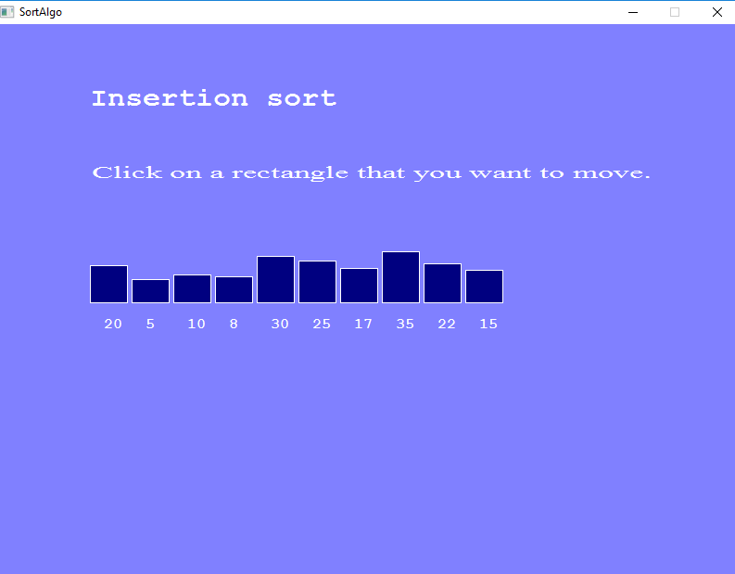
Manual Selection and Insertion Sort
Level 1
Level 1
Level 2
Level 2

Slide 16
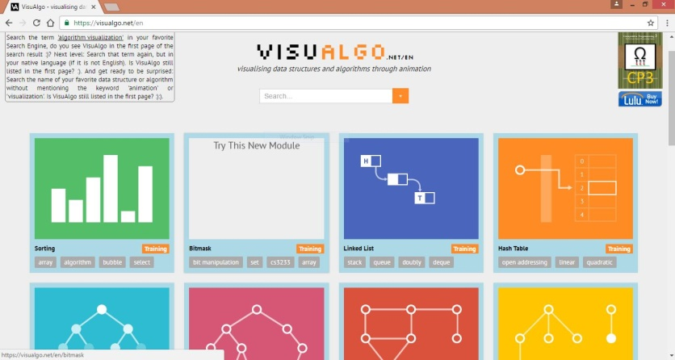
Special tribute
Visualgo.net

Slide 17
Overview
Great project to summarize the students knowledge on C and C++ language.
Better Platform for understanding Sorting Algorithms.

Slide 18
Our Experience
Real Life Implementation
Idea About Software Development
First Time Experience In User-Friendly Application
Teamwork

Slide 19
Thank you!

